Slide 1

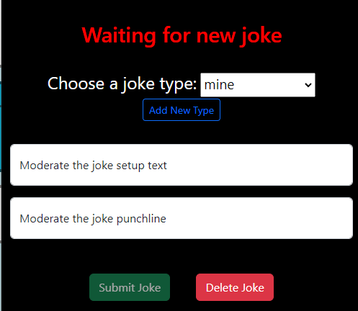
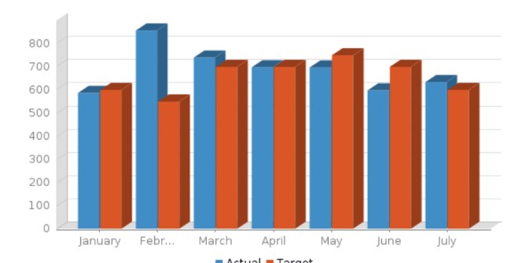
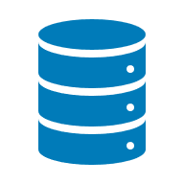
localhost
Local Machine
Option 1
Docker private network
Application container
Container port number
Application port number
/types
/types
/joke/:type
/submit
/docs
4000
4200
joke
submit
3000
3200
4002
database
3306 or 27017
db vol

Slide 2

Public internet
Virtual machine
Option 2
Azure private network
Application container
Docker private network
Rabbitmq combined container
Container port number
/types
/types
Application port number
/joke/:type
/submit
/docs
MQ admin
4000
4200
joke
/types
submit
3000
3200
types
4002
database
5672
15672
SUBMITTED_JOKES
rmq-admin
xxxx
db vol
5672
15672
public IP:
private IP:
4001
etl
submitted joke
3001
public IP:
private IP:

Slide 3
Public internet
Virtual machine
Option 3
Azure private network
Application container
Docker private network
Rabbitmq combined container
kong
Container port number
80 / 443
Application port number
public IP:
8445
private IP:
/types
/docs
/types
/joke/:type
MQ admin
/submit
4000
4200
question
/types
submit
3000
3200
types
4002
database
5672
15672
SUBMITTED_JOKES
rmq-admin
xxxx
db vol
5672
15672
public IP:
private IP:
4001
etl
submitted jokes
3001
public IP:
private IP:

Slide 4
Public internet
Virtual machine
Option 4
Azure private network
Application container
Docker private network
Rabbitmq combined container
80 / 443
Container port number
kong
public IP:
private IP:
Application port number
8445
/types
/types
/types
/joke/:type
/moderate
/submit
/moderated
/docs
4000
joke
public IP:
private IP:
public IP:
private IP:
3000
4100
4200
moderate
submit
4002
4002
types
MongoDB
MySQL
3100
3200
types
27017
3306
moderated
type_update
mysql
vol
type_update
submit
submit
15672
5672
rmq-admin
4001
RabbitMQ Broker
etl
moderated
mongo vol
3001
type_update
5672
15672
public IP:
private IP:
public IP:
private IP:

